Slide 1

Networked Infrastructure
for Community Enrichment

Slide 2
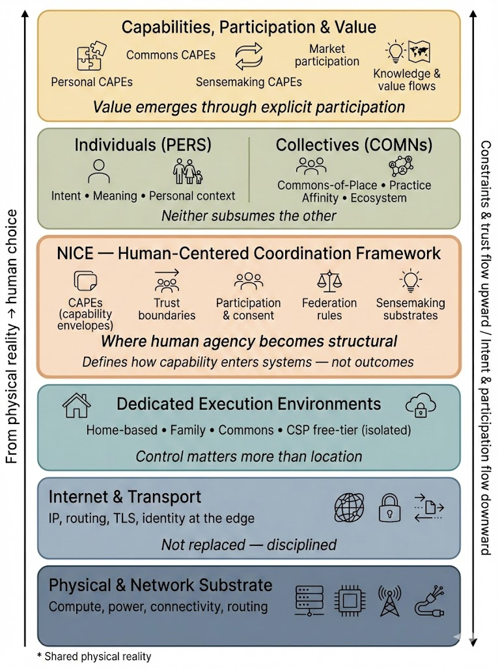
What NICE is – and why it matters
NICE - Networked Infrastructure for Community Enrichment
Digital systems increasingly shape what people see, prioritize, and act upon — often implicitly, at scale, and without clear accountability. As data volumes grow, interpretation shifts into opaque systems optimized for engagement, efficiency, or extraction rather than human understanding.
NICE exists to reverse that dynamic by restoring explicit human participation, agency, and standing — by design.
What makes NICE different
NICE makes it possible for people and collectives to explore knowledge, collaborate, and co-create without surrendering intent, custody, or accountability.
Advanced technology operates in service of human understanding — not at the expense of human judgment.
How NICE is structured
NICE is structured so that human choice comes first.
Explicit Constitutional protections that ensure people retain control — intent, consent, custody, accountability, and the ability to exit.
Platforms that encode those protections — replaceable, conforming implementations of shared rules that anyone may build.
A broad capability layer where people, businesses, markets, and institutions participate as peers — under clear, shared rules.
Why businesses benefit
NICE enables forms of collaboration that are not possible without trust. Organizations that operate transparently and respect human control gain access to new kinds of cooperation, products, and markets that cannot exist in today’s systems.
A protected space within an unprotected world
NICE does not replace today’s platforms or institutions. People will continue to use familiar systems. NICE offers something different: a place where participation is protected by design. As more people choose that protection, the ecosystem grows — not by force, but by alignment.
Core invariants
Outcomes emerge from participation — not from system authority
Understanding improves through engagement — not hidden optimization
Control is restored to humans — explicit and revocable
NICE - Networked Infrastructure for Community Enrichment
NICE Capability Layer — Peelable Packages (PeelPacks)
Commons
PeelPacks
Market participation
Personal PeelPacks
Sensemaking PeelPacks
Knowledge &
value flows
Value emerges through explicit participation
NICE Platform System
PERS Platforms (Individuals)
COMMONS Platforms (Collectives)
• Intent • Meaning • Personal context
• Ecosystem • Place • Practice • Affinity
Neither subsumes the other
NICE Constitutional System
PeelPack
envelope constraints
Trust boundaries
Participation
& consent
Federation rules
Sensemaking substrates
Constraints and trust propagate upward / Intent and participation flow downward
Where human agency becomes structural
Defines how capability enters systems – not outcomes
Inherited Infrastructure (Yes, we care about this!)
Physical Compute
Home • Edge • Data Center • CSP
|
Ownership • Isolation • Trusted Execution
Control matters more than location
Internet & Transport Protocols
IP, routing, TLS, Identity at the edge
Not replaced – disciplined
Physical Network Substrate
Connectivity, transport, routing, power
Focused on resiliency and environmental sustainability
Control, trust, and standing are determined first by infrastructure — then by coordination. We inherit the substrate, but we refuse to treat it as neutral.

Slide 3
Constitutional Constraint Topics (Inherited Infrastructure)
Human-meaningful dimensions that must be governed
NICE Inherited Infrastructure
Inherited Infrastructure — Constitutional Requirements
NICE does not exist in a vacuum. Human participation is constrained by physical compute, networks, power, ownership, and environment. For NICE’s constitutional protections to hold, these inherited layers must satisfy specific requirements.
These are not optimizations or preferences — they are structural conditions.
Implications for physical compute:
Because execution and custody affect human control:
Compute must be distributed by default (homes, local nodes, bounded environments)
Institutional compute must be accessed only through explicitly governed staging
Ownership and operational responsibility must remain legible
Implications for internet & transport protocols:
If identity and trust are not to be captured:
Identity must be anchored at the edge, not platforms
Peer-to-peer must be the default interaction model
Protocols must tolerate heterogeneity, failure, and partial trust
Implications for the physical network substrate:
If participation is to remain voluntary, auditable, and resilient:
Multiple transport paths must exist (fiber, radio, satellite)
Control points must be explicit, inspectable, and contestable
Redundancy and failover must be architectural, not exceptional
Power, routing, and access must function as governed surfaces, not neutral utilities
Constitutional Invariants
If human participation is to remain protected, the following invariants must hold:
No silent gatekeeping — authority must be declared
Participants operate as peers — no privileged network positions
Resilience is mandatory — failure is assumed
Stewardship is required — infrastructure carries responsibility
NICE makes these implications explicit so they cannot be hidden, ignored, or quietly centralized by power or scale.
Physical Compute
• Control → who decides and who can act
• Trust → what guarantees exist
• Human Experience → how participation feels
Control matters more than location
Internet & Transport Protocols
IP, routing, TLS, Identity at the edge
• Visibility → who can see or observe
• Reachability → who can contact whom
• Routing Power → who controls paths and priority
Not replaced – disciplined
Physical Network Substrate
Connectivity, transport, routing, power
• Power & Rights → who owns and can exclude
• Resilience → whether it endures failure
• Non-negotiable Reality → what cannot be overridden
Focused on resiliency and environmental sustainability
Shared constraints: ownership, jurisdiction, routing, latency, custody, failure modes

Slide 4
NICE Constitutional System
Participation Map
NICE Constitutional System
Constitutional Participation Map
This diagram defines the fixed participation boundaries of NICE — the constitutional conditions that apply before platforms, products, or implementations exist. These boundaries define who may participate, under what conditions, and with what limits on power. They do not produce outcomes.
Human authority originates once — and only once
Human authority originates with the human and is expressed through a singular constitutional trust boundary in NICE. This boundary defines the origin of intent, consent, custody, and context for interpretation, as well as authorization. No platform, collective, or system may originate authority, reinterpret intent, or override human standing.
Participation is evaluated, not executed
Participation declarations are evaluated and matched, not executed. A singular constitutional evaluation boundary exists to evaluate declared participation, determine eligibility, and define permitted execution contexts. This boundary matches declarations to allowed contexts without executing, governing, or producing outcomes. Coordination is mediated; action remains downstream.
Collective participation is governed, not empowered
Collective participation occurs only under explicit, inherited rules. A singular constitutional governance boundary defines the rules under which collective participation is permitted and execution may occur. This boundary does not generate human intent or authority; it constrains and inherits it. Execution is permitted by rule, not driven by power. While collective participation is evaluated constitutionally, its declarations are physically realized through human participation via PERS, acting in an appropriate role on behalf of the collective.
Collective governance is inherited by structure
Governed collectives inherit participation constraints from constitutional root categories. Inheritance is cumulative and narrowing: constraints may be added, but never relaxed. This ensures collective action can scale without capture, escalation, or authority leakage.
Execution follows permission — not power
The NICE Constitutional System defines where participation is allowed, not what outcomes must occur. Execution is always downstream, always bounded, and always permitted by constraint — never by discretion or command. Conditions are defined, not outcomes.
Human Authority & Personal Trust Boundary (Constitutional Plane - Singular)
Human Authority Origin & Trust Boundary
Constitutional Surface - Singular
The constitutional boundary where human intent, consent, custody, and sensemaking originate — once, and only once — without delegation or substitution.
Declared human intent & consent (authoritative)
Declared Participation Mediation (Constitutional Plane - Singular)
Declaration Evaluation & Eligibility Boundary
Constitutional Surface - Singular
The constitutional boundary where participation declarations are evaluated, attested, and matched to permitted execution contexts — without executing, governing, interpreting intent, or originating authority.
Eligibility determination & permission scope
Governed Collective Participation (Constitutional Plane, Plural, Governed)
Commons Operational Constraint Boundary
Define inheritance categories for governance constraints.
The constitutional boundary where attested constraint sets are aggregated.
Categories of Collective Governance Inheritance
Define inheritance categories for governance constraints.
• Infrastructure • Identity • Intent
• Place • Practice • Affinity
• Commerce • Knowledge
Rules for Collective Participation & Execution Permission
Constitutional Surface - Singular
The constitutional boundary where collective participation is governed and execution is permitted under explicit rules — without generating intent, authority, or standing.
* Commons Inheritance Rule
Instantiated Commons inherit governance, constraints, and eligibility from one or more upstream Commons. Inherited constraints are cumulative and may be narrowed, but never relaxed or bypassed.
Arrows indicate permission and eligibility boundaries — not execution flow.

Slide 5

NICE Constitutional System
Personal Trust Boundary
NICE Constitutional System
Personal Trust Boundary
NICE begins with the human.
This constitutional surface defines the conditions under which a human may express intent, grant consent, hold custody, authorize bounded execution, and engage sensemaking — without delegating authority.
Nothing happens without the human
Nothing may enter, execute, persist, or be interpreted without explicit human authorization. This is the primary constitutional trust boundary of NICE.
Enforcement without origination
This boundary enforces declared intent, consent, and execution constraints and maintains continuity with human-declared context. It does not originate intent, interpret meaning, infer objectives, or initiate action.
Authority originates once — and only once
Human authority originates with the human and is expressed through a singular constitutional trust boundary. No platform, system, collective, or process may originate authority, reinterpret intent, or override human standing.
Assistance without delegation
Sensemaking assistance may render options, tradeoffs, and implications legible to the human, but never initiates action, narrows choice, substitutes judgment, or produces decisions. Alignment at the trust boundary preserves context; interpretation occurs only when explicitly invoked by the human.
Custody and execution are separated by design
Custody of identity and data remains with the human, including third-party data entrusted under declared terms. Execution by external execution systems is permitted only within declared, attested constraints.
Constitutional invariant
The NICE Constitutional System is not a platform and does not act. It defines the conditions under which humans may safely and intentionally participate — and nothing more.
Sensemaking is protected constitutionally as a first-class function because human cognition is limited and must not be exploited, bypassed, or replaced.
Shown components represent constitutional roles, not implementations. Multiple conforming implementations may exist.
Human Authority & Personal Trust
Constitutional Plane - Singular
Constitutional plane defining the singular origin of human intent, consent, custody, authorization, and sensemaking — without delegation.
Human Authority Origin & Trust Boundary
Constitutional Surface – Singular
The human’s sovereign boundary where intent, consent, custody, authorization, and context for interpretation originate — with no initiation, decision, or execution outside the human. Contextual alignment preserves continuity of declared context; it does not infer goals, optimize behavior, or act in advance of human observation.
The gate enforces; it does not originate.
Trust Boundary Gate
Governance, Attestation & Translation Declaration
Declares enforcement for ingress and egress according to declared human intent and execution constraints — including assistive context. Translates between external capabilities and internal trust boundaries — without originating action.
Authorized
Intent
Attested
Execution
Human authority origin (persona / role) declared)
Authorized Execution Declaration
Human Intent/Consent Declaration
Attestation / Receipt
Confined, Attested Execution
Intent, Consent, & Review
Declares where and how execution is allowed once explicitly authorized by the human. External capabilities may run only within declared limits for confinement, reliability, and confidentiality, and only with verifiable attestation.
Declares human intent and consent, and records authorization decisions.
Participation originates here — explicitly, reviewably, and revocably — without executing actions.
Attested Result
Authorization Request
Protects third-party IP without taking over.
Review
Interpretation and Sensemaking
Personal Custody Declaration
Sensemaking Assistance
Human-Custrodied Identity & Data
Human-Instigated Cognitive Offload
Declares which identity and data artifacts are held in the human’s custody.
May include personal data and third-party data entrusted to the human under declared access, retention, and handling terms, regardless of data origin.
Declares interpretive assistance that renders options, tradeoffs, and implications legible — without initiating action, narrowing choice, or producing decisions.
Nothing in or out without explicit permission.
Agents that know their place.
Arrows indicate authorization and constraint propagation — not execution flow
Solid = authority/constraints • Dashed = assistance
NICE is governed by enforceable architectural constraints that preserve human agency: assistive systems are non-agentic by design; execution and persistence require explicit human authorization; and all trust boundaries are auditable and attested. Governance mechanisms provide transparency, appeal, and exclusion for non-conforming participants.

Slide 6
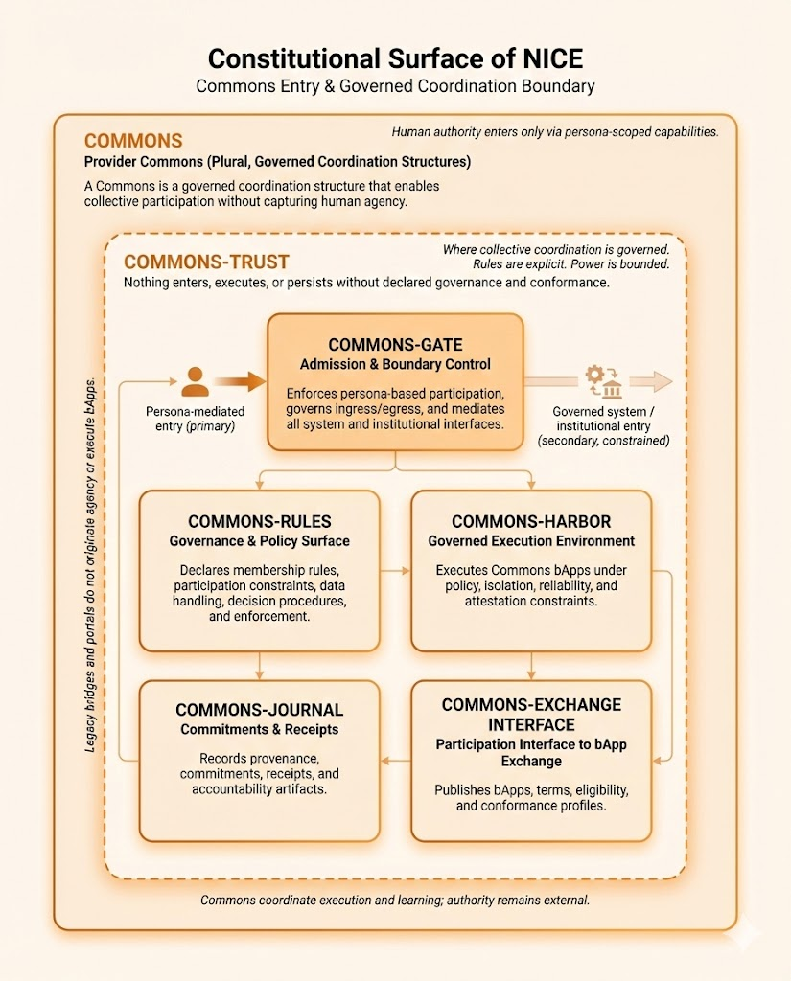
NICE Constitutional System
Governed Coordination Boundary
NICE Constitutional System
Governed Collective Coordination
Participation without capture
This constitutional surface defines the conditions under which collective participation may occur. It enables coordination under explicit, inherited rules — without originating human intent, authority, or outcomes. The constitution defines where and under what constraints collective action is allowed. It does not decide what must be done.
Human authority enters only through constrained participation
All collective participation is mediated by persona-scoped declarations issued upstream through the personal trust boundary. Human authority is never transferred to the collective. It is constrained, scoped, and exercised only through declared roles and permissions.
Admission and routing are declared — not discretionary
An admission and routing declaration specifies: Who may participate; Under which roles; Which actions may be taken; Which execution paths are permitted. No declaration grants authority to execute, decide outcomes, or relax constraints. It only permits participation under rule.
Collective constraints are explicit and inherited
Collective constraint declarations define the rules, limits, procedures, and handling requirements that govern participation. Constraints are: Explicit; Inherited from upstream governance; Cumulative and narrowing. They may be added — never removed.
Execution conditions are permitted, not commanded
A governed execution declaration specifies the conditions under which collective execution may occur. It defines: Permitted execution contexts; Required isolation, reliability, and attestation conditions. Execution is always bounded by declaration and may be plural across permitted contexts.. No single surface controls outcomes.
Accountability is recorded, not enforced
Commitment and accountability declarations ensure that: Commitments, receipts, and provenance are recorded; Participation is auditable after the fact. Accountability is established without control, custody, or enforcement power.
Participation terms are published, not hidden
External participation publication declares: Eligibility criteria; Participation terms; Conformance artifacts. These are published externally to enable transparent participation — without granting authority, custody, or decision-making power.
Constitutional invariant
This constitutional surface coordinates collective participation. It does not generate intent, authority, or outcomes. NICE defines where collective participation is allowed — and under what conditions. That’s it.
Human authority enters only via persona-scoped capabilities.
Governed Collective Coordination
Constitutional Plane – Plural, Governed
A constitutional plane that enables collective participation under explicit, inherited rules — without originating intent, authority, or decisions.
Collective Governance Boundary
Constitutional Surface – Singular
Where collective coordination is governed. Rules are explicit. Power is bounded.
The constitutional boundary where collective participation is governed. Admission, execution, and persistence are permitted only under explicit rules and conformance.
Admission & Routing Declaration
Declared Role-Scoped Participation
Admission, Role Scope, & Permitted Action Routing
Declares who may participate, under what roles, and which actions may be routed for execution. Declares the permitted action paths into governed execution. Does not execute actions, decide outcomes, or relax constraints.
Governed system / institutional entry (secondary, constrained)
Standing, receipts & auditability
Governed action routing (permissioned)
{Holonic Inheritance}
Execution may be plural; governance constraints are singular and mandatory.
Collective Constraint Declaration
Governed Execution Declaration
Rules and Constraints
Declared
Execution
constraints
Conditions for Permitted Collective Execution
Legacy bridges and portals do not originate agency or execute PeelPack contents.
Declares the conditions under which collective execution may occur.
Execution is permitted only within declared constraints, isolation, reliability, and attestation requirements.
Declares participation rules, constraints, procedures, and handling requirements for collective action. Constraints are explicit, inherited, and machine-readable for enforcement and audit.
Declared Accountability Constraints
Conformance & eligibility publication
Commitments & Receipts
Commitments Declaration
External Participation Publication
Accountability & Audit
Published Participation Artifacts
Declares how commitments, receipts, and provenance are recorded for collective action. Enables accountability and audit without conferring control or enforcement power.
Declares how participation terms, eligibility criteria, and conformance artifacts are published externally. Enables transparent coordination without custody, control, or decision-making authority.
Collective coordination is governed by declared constraints; it does not originate intent, authority or decisions.
Arrows indicate authorization and constraint propagation — not execution flow
Solid = authority/constraints • Dashed = assistance
Declared Participation
Artifacts
(external)
The Commons drill-down defines the constitutional surfaces every Commons must expose; how standards are realized, composed, or inherited is intentionally deferred to higher-resolution layers.

Slide 7
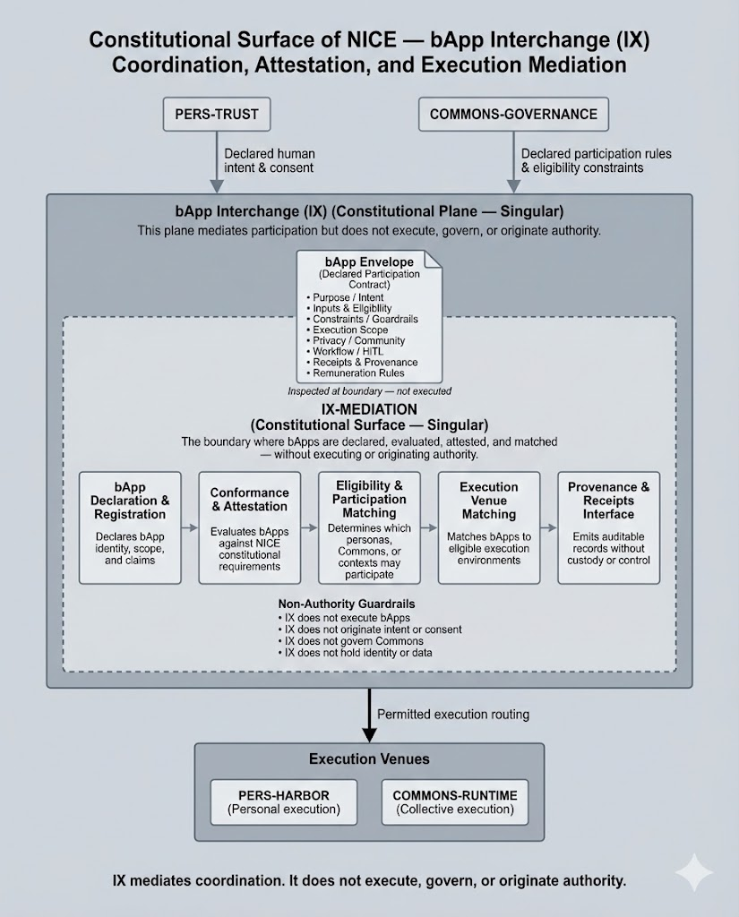
NICE Constitutional System
Intermediation Boundary for Declared Participation
NICE Constitutional System
Intermediation Boundary for Declared Participation
Participation is mediated — not executed
This constitutional surface defines how declared participation is interpreted and reconciled across NICE. It mediates between declared intent, declared rules, and permitted execution — without executing, governing, or deciding outcomes.
Participation occurs through declaration
All participation is expressed as explicit declarations:
participation intent and scope,
conformance requirements,
participation availability,
eligibility contexts,
commitments and provenance.
Declarations are inspected and reconciled at the boundary — never executed here.
Compatibility is evaluated. Permission is matched.
This boundary determines whether declared participation is:
compatible with constitutional requirements,
eligible across personas, collectives, and contexts,
permitted within declared execution boundaries.
It matches participation to permission. It does not grant discretion, authority, or control. The envelope may declare interpretive affordances, but never execution logic or behavioral intent.
Execution is downstream and bounded
When execution occurs, it does so only in venues authorized by existing trust and governance boundaries. This surface makes permission legible; it does not select, initiate, or route execution.
Accountability without control
Execution venues return receipts and attestations through this boundary. These artifacts establish transparency and auditability without conferring custody or enforcement power.
Constitutional invariant
The Intermediation Boundary enables coordination without central platforms, hidden gatekeepers, or delegated authority. Participation is mediated. Authority remains human.
Human Authority Origin & Trust Boundary
Collective Governance Boundary
Declared human
intent & consent
Declared participation rules & eligibility constraints
Intermediation for Declared Participation
(Constitutional Plane – Singular)
Declared Participation
(PeelPack Envelope)
• Purpose / Intent
• Inputs & Eligibility
• Constraints / Guardrails
• Execution Scope
• Privacy / Community
• Workflow / HiTL
• Receipts & Provenance
• Remuneration Rules
A Constitutional Plane governing intermediation between declared participation and permitted execution.
Declared participation envelope (inspection only)
Intermediation Boundary for Declared Participation
Constitutional Surface – Singular, Enclosed)
Defines the boundary within which declared participation, governance constraints, and execution permissions may be interpreted — without originating intent, authority, or standing.
Inspected at boundary
– not executed
Participation Declaration
Conformance Declaration
Participation Availability Declaration
Eligibility Declaration
Commitment & Provenance Declaration
Declared intent, role, and scope
Declared compliance with required constraints
Declared participation availability
Declared allowed participation contexts
Declared commitments and receipts
Non-Authority Guardrails
• never executes PeelPack contents
• never originates intent or consent
• never governs Commons
• never holds identity or data
Permitted Execution Paths
Execution receipts & attestations (non-authoritative)
Execution Venues
Human Authority Origin & Trust Boundary
Collective Governance Boundary
Arrows indicate authorization and constraint propagation — not execution flow
Solid = authority/constraints • Dashed = assistance

Slide 8
NICE Constitutional System
Participation Declaration (Non-Executable)
NICE Constitutional System
Participation Declaration
Declarative, not executable
The Participation Declaration defines how the contents/payload of a NICE PeelPack may be used. It is a structured declaration of intent, scope, and constraints — not a description of behavior or execution.
Authored by participants. Available for inspection at the boundary.
Participation Declarations are authored by NICE participants and made available to the Intermediation Boundary when participation is evaluated.
Conditions are declared — actions are not
The declaration specifies:
what a PeelPack is intended to do,
what inputs and contexts it may rely on,
where execution may occur,
and which constraints must always hold.
It does not define how execution happens, guarantee outcomes, or authorize action.
Used for matching – not permission
Participation Declarations are consulted to evaluate compatibility across:
what a PeelPack is intended to do,
what inputs and contexts it may rely on,
where execution may occur,
They enable matching — not control, discretion, or enforcement.
Execution remains downstream and bounded
When participation is permitted, execution venues reference the declaration unchanged, operating under human authority and existing governance boundaries.
Constitutional invariant
Participation is declared, not commanded.
Declarations are pulled for inspection, not pushed for execution.
Conditions are inspected, not enforced.
Execution remains downstream. Authority remains human.
Participation Declaration
Envelope for a Peelable Package (PeelPack) – Non-Executable
Authored by NICE Participant. Inspected at Intermediation Boundary.
Purpose / Intent
• Declared goals and function
• No outcome guaranteed
Inputs & Eligibility Claims
• Required inputs
• Persona, Commons, or context
eligibility claims
Purpose / Intent
Constraints / Guardrails
• Operational limits
• Policy, legal, safety, or
constitutional constraints
Declared Execution Scope
• Permitted execution venues
• Explicit exclusions
• No execution logic or instructions
Privacy / Community Posture
• Data handling declarations
• Community or Commons
sensitivity markers
Declared Oversight Conditions
• Review, approval, escalation points
• No automation mandates
Receipts & Provenance
• Declared audit expectations
• Receipt formats and traceability
claims
Declared Remuneration Terms
• Compensation logic (if any)
• No pricing enforcement or custody
Consulted for eligibility, conformance, and execution matching
Retrieved downstream for execution – unchanged
Non-Executable by Design
• Cannot execute code
• Cannot grant permission
• Cannot enforce policy
• Cannot hold data or identity
The Participation Declaration declares conditions, not actions.
Execution remains downstream. Authority remains human.

Slide 9
NICE Platform System
Participation Map
NICE Platform System
Platform Participation Map
NICE separates authority from execution
Platforms exist to make constitutional participation usable at human scale — without absorbing authority, discretion, or intent. Humans retain constitutional standing at all times. Platforms do not hold authority — they realize conditions under which participation is possible.
PERS — Makes sovereign human participation usable and safe
PERS is the human trust boundary. It anchors identity, intent, consent, custody, authorization, and continuity of declared context to a specific human under PERS-TRUST. All participation originates here — explicitly, revocably, and audibly. PERS enables action without delegating authority. Authority, intent, and standing remain human.
PERS-TRUST maintains continuity and alignment with human-declared context and constraints. Interpretation and meaning-making occur only through explicit human-invoked assistance and never at the boundary itself.
TIX — Makes plural participation interoperable
TIX is the constitutional mediation plane. It reconciles declarations, eligibility, conformance, and execution paths across many PERS and many Commons — without executing, governing, or taking custody.
TIX publishes eligibility and permission scope; recipients evaluate participation options and route execution under their own authority. TIX does not interpret meaning or provide sensemaking; it reconciles declared participation only. It matches participation; it does not decide outcomes or grant discretion.
COMMONS — Makes collective participation productive
Commons are where collective execution and shared value creation occur. Activities are collective, rule-bound, auditable, and accountable — but always constrained by governance inherited from upstream.
Commons act at scale without overriding individual agency. Execution is plural; governance is singular and mandatory.
The core invariants
• Platforms realize conditions.
• Authority remains human and constitutional.
• Outcomes remain open.
PERS (Personal Mesh Node)
Human-owned platform plane that realizes sovereign participation under PERS-TRUST.
PERS-TRUST (Personal Trust Boundary)
Platform boundary that enforces declared intent, consent, custody, and execution constraints – anchored to the human.
PERS-ENABLE ▢▢▢
Implementation platforms that make sovereign human participation usable.
PERS-HOME
PERS-VAULT
PERS-HARBOR
PERS-LENS
Human-Owned
Mediation Environment
Personal Data &
Identity Vault
Hardened, Available
Runtime for Bounded
Owner-Hosted Resources
Legible Environment for Navigating Sensemaking
PERS-ENABLE implement PERS-TRUST constraints; they do not originate authority.
Permitted participation flow
TIX (Trusted Interchange)
Platform plane that enables mediated participation across many humans and many Commons.
TIX-MEDIATION
Platform boundary that enforces mediation constraints across plural actors.
TIX-ENABLE ▢▢▢
Implementation Platforms that make plural participation interoperable.
TIX-REGISTRY
TIX-VERIFIER
TIX-RELAY
TIX-MATCHER
TIX-JOURNAL
Registration of PeelPacks
PeelPack conformance and attestation
Publication of
participation availability
PeelPack eligibility and attestation
Document provenance & receipts
TIX-ENABLE platforms mediate coordination across PERS & COMMONS; they do not execute, govern, or originate authority.
COMMONS
Platform plane where collective action and shared value creation occur.
COMMONS-GOVERNANCE
Platform boundary that declares and enforces the rules of collective participation.
COMMONS-ENABLE ▢▢▢
Implementation platforms that make collective participation productive.
COMMONS-RUNTIME
COMMONS-RULES
COMMONS-JOURNAL
COMMONS-TIX-ONRAMP
Executes Commons PeelPacks bounded by envelope’s participation declaration.
Declares rules, constraints, data handling, decision procedures, & enforcement.
Records provenance, commitments, receipts, & accountability artifacts.
Publishes PeelPack envelopes & conformance profiles to the TIX.
COMMONS-ENABLE Platforms implement COMMONS-GOVERNANCE constraints. Execution is collective and bounded.
PERS-ENABLE
TIX-ENABLE
COMMONS-ENABLE
Makes sovereign human participation usable
Makes plural participation interoperable
Makes collective participation productive
Platforms realize conditions. Authority remains constitutional. Outcomes remain open.

Slide 10







NICE Platform System
PERS - Human-Authorized Personal Execution & Assistance
NICE Platform System
PERS - Human-Authorized Personal Execution & Assistance
The PERS Platform Plane (NICE-RS-PERS) defines how human-sovereign participation is made operational in NICE — without transferring authority, standing, or decision-making away from the human. Platforms at this layer do not decide what is allowed. They realize and enforce conditions declared upstream by the constitutional system, not outcomes.
PERS-TRUST — Enforcement boundary & sensemaking substrate
PERS-TRUST (NICE-RS-PERS-TRUST) is the enforcement boundary of the plane and the substrate that remains in lock-step with the human. It enforces declared intent, consent, custody, and execution constraints, and provides attestation of outcomes.
This substrate is analogous to an operating system: it maintains continuous coherence with the human, so declared intent is ready to be acted upon when — and only when — the human initiates action. It does not infer goals, interpret meaning, optimize behavior, or make decisions.
Platform roles (implementation platforms)
Within this boundary, a set of implementation platforms realize these constraints in practice:
PERS-GATE — governance, translation, and attestation
PERS-HOME — human-owned mediation and authorization
PERS-HARBOR — hardened, attestable execution environment
PERS-VAULT — human-custodied identity and personal data
PERS-LENS — non-authoritative sensemaking and interpretive assistance
Each platform has a defined role, is governed by a Role Standard, and may have multiple conforming implementations. None originate authority or standing.
Interfaces, not authority
All interaction between PERS platforms occurs through explicit Interface Standards (NICE-IS-*). Interfaces route, constrain, and attest participation flows — they never decide, govern, or take custody.
Core invariant
Platforms realize conditions. Authority remains constitutional and human.
PERS
Human-Owned Platform Plane
NICE-RS-PERS
Human-owned platform plane that realizes sovereign participation under PERS-TRUST.
NICE-RS-PERS-TRUST
PERS-TRUST (Personal Trust Boundary)
human→HOME→GATE→HARBOR
Platform realization of the human trust boundary — enforcing constitutionally declared intent, consent, custody, execution constraints, and sensemaking conditions.
PERS-GATE enforces; it does not originate.
TIX Participation Mediation
NICE-IS-PERS-TIX (BUNDLE)
PERS-GATE
Governance, Attestation & Interpretation Environment
NICE-RS-PERS-GATE
TIX-MEDIATION
Enforces ingress and egress according to declared intent, policy, and execution envelopes.
Intent & Consent Submission
NICE-IS-PERS-INTENT-SUBMIT
Attested Outcome
NICE-IS-PERS-EXECUTION-ATTEST
Constrained Execution Request
NICE-IS-PERS-EXECUTE
Where humans start.
PERS-HOME
PERS-HARBOR
Human-Owned
Mediation Environment
NICE-RS-PERS-HOME
Hardened, Available Runtime for
Bounded Owner-Hosted Resources
NICE-RS-PERS-HARBOR
Human-owned mediation environment for expressing intent, granting consent, and reviewing actions under PERS-TRUST.
Hardened, available execution environment for owner-hosted resources operating under declared execution envelopes and attested constraints.
Protects third-party IP without taking over.
Authorized Data Surface
NICE-IS-PERS-VAULT
Guidance & Sensemaking
NICE-IS-PERS-GUIDANCE
PERS-VAULT
PERS-LENS
Human-Custodied
Personal Data Store
NICE-RS-PERS-VAULT
Legible Environment for Navigating Sensemaking
NICE-RS-PERS-LENS
Human-custodied data and identity store governed by retention and access constraints enforced by PERS-TRUST.
Human-subordinate sensemaking and guidance system that interprets options and surfaces implications without acting or deciding.
Nothing in or out without explicit permission.
Agents that know their place.
These implementation platforms realize PERS-TRUST constraints.
They enforce declared envelopes; they do not originate authority, standing, or rights.
• Boxes = Role Standards (RS). • Lines = Interface Standards (IS). • Implementations are plural and conforming.

Slide 11
NICE Platform System
Commons - Commons Mesh Node
NICE Platform System
Commons - Commons Mesh Node
The COMMONS Platform Plane (NICE-RS-COMN) defines how collective participation is made operational in NICE — without transferring authority, intent, or standing away from humans.
Platforms at this layer do not decide outcomes or permissions. They realize and enforce conditions declared upstream by the constitutional system.
COMMONS-GOVERNANCE — The enforcement boundary
COMMONS-GOVERNANCE (NICE-RS-COMN-GOV) is the enforcement boundary of the plane. It ensures that nothing enters, executes, or persists without declared governance, participation constraints, and accountability requirements. COMMONS-GOVERNANCE enforces constraints; it does not originate authority, intent, or outcomes of its own.
Platform roles (implementation platforms)
Within this boundary, a set of implementation platforms realize these constraints in practice:
COMMONS-GATE — admission, boundary control, and permitted execution routing
COMMONS-RULES — declaration of participation rules and constraints
COMMONS-RUNTIME — governed collective execution environments
COMMONS-JOURNAL — commitments, receipts, and accountability artifacts
COMMONS-TIX-INTERFACE — publication of participation terms to TIX
Each platform has a defined role, is governed by a Role Standard, and may have multiple conforming implementations. None originate authority or intent.
Interfaces, not authority
All interaction between Commons platforms occurs through explicit Interface Standards (NICE-IS-*). Interfaces route, constrain, and attest participation flows — they never decide, govern, or take custody.
Core invariant
• Platforms realize conditions.
• Authority remains constitutional and human.
• Execution may be plural; governance is singular.
• Outcomes remain open.
COMMONS
The Collective Execution Platform Plane
NICE-RS-COMN
The COMMONS Platform Plane defines how collective participation is made operational in NICE, under explicit governance constraints and without transferring authority, intent, or standing away from humans.
NICE-RS-COMN-GOV
COMMONS-GOVERNANCE (Governed Execution Boundary)
Implementation platforms — plural and replaceable
Platform boundary that realizes governance constraints declared upstream. It ensures that collective execution occurs only within declared rules, scopes, and accountability requirements.
COMMONS-GATE enforces; it does not originate.
COMMONS-GATE
Admission & Boundary Control
NICE-RS-COMN-GATE
Standing & Accountability Signals
NICE-IS-COMN-JOURNAL-STANDING
Enforces ingress and egress according to declared governance rules and execution envelopes.
Routes permitted actions to governed execution
surfaces. Does not execute, decide, or relax constraints.
Eligibility & Participation Context
NICE-IS-COMN-TIX-CONTEXT
Declared Governance Constraints
NICE-IS-COMN-GOV-CONSTRAINTS
Permitted Execution Routing
NICE-IS-COMN-EXEC-ROUTING
COMMONS-RULES
COMMONS-RUNTIME ▢▢▢
Human-Owned Mediation Environment
NICE-RS-COMN-RULES
Governed Execution Environment
NICE-RS-COMN-RUNTIME
Publishes explicit participation rules, constraints, procedures, and enforcement conditions as declared by the Commons. Provides a machine-readable governance surface for enforcement and audit.
Executes Commons PeelPacks only within declared governance, isolation, reliability, and attestation constraints. Execution may be plural; governance constraints are mandatory and singular.
Commitments & Execution Receipts
NICE-IS-COMN-RUNTIME-RECEIPT
Accountability Constraints
NICE-IS-COMN-RULES-ACCOUNTABILITY
Commitments & Execution Declarations
NICE-IS-COMN-RUNTIME-DECLARE
COMMONS-JOURNAL
COMMONS-TIX-INTERFACE
Commitments & Receipts
NICE-RS-COMN-JOURNAL
Participation Interface to Trusted Interchange (TIX)
NICE-RS-COMN-TIX
Records commitments, execution receipts, provenance, and accountability artifacts. Provides auditability without conferring control or enforcement power.
Publishes Commons participation terms, eligibility criteria, and conformance profiles to TIX.
Enables interoperability without granting permission or custody.
These implementation platforms realize TIX-MEDIATION constraints.
They enforce declared envelopes; they do not originate authority, standing, or standing.
• Boxes = Role Standards (RS). • Lines = Interface Standards (IS). • □□□ = plural, replaceable execution environments

Slide 12
NICE Platform System
TIX – Trusted Interchange
NICE Platform System
TIX – Trusted Interchange
The TIX Platform Plane (NICE-RS-TIX) defines how plural participation is made interoperable in NICE — without transferring authority, intent, or standing from humans or Commons. Platforms at this layer do not decide what is allowed. They mediate, reconcile, and route constitutionally-constrained participation declarations.
TIX-MEDIATION — The mediation boundary
TIX-MEDIATION (NICE-RS-TIX-MED) is the singular mediation boundary of the plane. It ensures that participation across many PERS and many COMMONS is compatible, bounded, and auditable — without executing, governing, or directing outcomes.
TIX-MEDIATION enforces declared constraints; it does not originate authority, grant permission, interpret meaning or execute actions.
Platform roles (implementation platforms)
Within this boundary, a set of implementation platforms realize mediation in practice:
TIX-REGISTRY — declaration and registration of PeelPack participation envelopes
TIX-VERIFIER — conformance and attestation against declared requirements
TIX-MATCHER — eligibility and participation context matching
TIX-RELAY — publication of participation availability (mediated)
TIX-JOURNAL — receipts, attestations, and provenance records
Each platform has a defined role, is governed by a Role Standard, and may have multiple conforming implementations. None originate authority, intent, or outcomes.
Interfaces, not authority
All interaction between TIX platforms occurs through explicit Interface Standards (NICE-IS-*). Interfaces declare, attest, reconcile, publish, and record participation flows — they never decide, govern, notify, or take custody. Publication expresses availability; participation is evaluated and routed by recipients under their own authority — never by TIX.
Core invariant
• Platforms realize conditions. Authority remains human and constitutional.
• Execution remains downstream.
• Outcomes remain open.
TIX
The Trusted Interchange Platform Plane
NICE-RS-TIX
The TIX Platform Plane defines how trusted interchange is made operational in NICE — the act of mutually giving and receiving between attested estates. TIX matches, mediates, and records; it never executes, holds custody, or decides.
NICE-RS-TIX-MED
TIX-MEDIATION (Enforcement Boundary - Singular) ▢▢▢
Implementation platforms — plural and replaceable
Platform boundary that verifies declared envelopes, reconciles eligibility, attests crossings; it records — never vouches, decides, or holds.
Conformance Results
NICE-IS-TIX-ATTEST
TIX-REGISTRY
TIX-VERIFIER
Declaration & Registration
NICE-RS-TIX-REGISTRY
Conformance & Attestation
NICE-RS-TIX-VERIFIER
Receives declared PeelPack participation envelopes and associated metadata. Records declarations without interpreting, approving, or executing them.
PeelPack Declarations
NICE-IS-TIX-REGISTER
Evaluates declared PeelPack envelopes against required conformance profiles. Produces attestations without granting permission or authority.
Registration Receipt
NICE-IS-TIX-JOURNAL-REGISTER
TIX-JOURNAL
Conformance Attestations
NICE-IS-TIX-JOURNAL-ATTEST
Receipts & Provenance
NICE-RS-TIX-JOURNAL
Records declarations, attestations, matching outcomes, and execution receipts. Provides provenance and accountability without control or enforcement power.
Matching Outcomes
NICE-IS-TIX-JOURNAL-MATCH
Routing Decisions
NICE-IS-TIX-JOURNAL-ROUTE
TIX-MATCHER
TIX-RELAY
Eligibility Matching
NICE-RS-TIX-MATCHER
Participation Availability
NICE-RS-TIX-RELAY
Resolves eligibility and participation compatibility across personas, Commons, and contexts without granting authority or deciding outcomes.
Permitted Participation Paths
NICE-IS-TIX-MATCH
Publishes participation availability for recipient evaluation.
These implementation platforms realize COMMONS-GOVERNANCE constraints.
They enforce declared envelopes; they do not originate authority, standing, or standing.
• Boxes = Role Standards (RS). • Lines = Interface Standards (IS). • □□□ = plural, replaceable execution environments

Slide 13
Networked Infrastructure
for Community Enrichment

